Slide 1


KIET School of Engineering & Technology, Ghaziabad
Department of Computer Science Engineering(AI&ML)
Major Project Presentation
Psychbuddy
Group Number: 12
Member names and Roll nos.: Gaushi(22), Akshit(05), Sarthak(48), Vatsa(60)
Guide name : Bhawna Ma’am

Slide 2
Major Project presentation
Table of Content
Problem statement
Objectives
Literature Review
Methodology
Implementation
Result
Conclusion
References

Slide 3
Major Project presentation
Problem Statement
Access to mental health support is often limited by barriers such as stigma, cost, and a shortage of trained professionals. Additionally, individuals seeking help may feel uncomfortable expressing their feelings in traditional settings. There is a need for a solution that provides an accessible, non-judgmental, and engaging platform for users to share their thoughts and access basic mental health guidance, available 24/7. By leveraging AI and voice interaction, this solution can make mental health support more inclusive and readily available.

Slide 4
Major Project presentation
Objectives
Enhance Accessibility: Provide 24/7 voice-enabled mental health support, ensuring users can access help anytime and anywhere.
Reduce Stigma: Create a private, non-judgmental environment where users feel comfortable discussing their mental health.
Provide Immediate Guidance: Offer practical advice and coping strategies for common mental health challenges, fostering well-being.

Slide 5
Major Project presentation
Literature Review
Voice-enabled mental health chatbots are gaining traction as effective tools for providing accessible, stigma-free support. Voice interactions are particularly beneficial in reducing barriers to mental health help-seeking, as they create a more natural and private means of communication. Research has demonstrated that voice-based interfaces can increase user comfort, making it easier to discuss sensitive topics like mental health (Holt et al., 2019).
AI technologies, including natural language processing (NLP) and machine learning, have revolutionized mental health care by powering virtual assistants capable of offering personalized, real-time support. Chatbots like Woebot and Wysa have proven effective in delivering cognitive-behavioral therapy (CBT) techniques, mood tracking, and emotional support, particularly for users facing accessibility challenges (Fitzpatrick et al., 2017). These tools are particularly impactful for those who may not have access to traditional mental health services due to cost, location, or stigma (Fulmer et al., 2018).
Privacy and data security are critical concerns in the development of mental health chatbots. Users expect stringent safeguards for personal information, particularly when discussing sensitive mental health issues. Ensuring compliance with privacy regulations like GDPR and HIPAA is essential for maintaining trust (Ribeiro et al., 2021).
Additionally, studies show that regular engagement with mental health chatbots can lead to significant improvements in mood, anxiety, and overall well-being (Liu et al., 2020). AI-driven platforms that analyze user input can provide tailored interventions, further enhancing user engagement and the effectiveness of mental health support.
Overall, voice-enabled AI chatbots represent a promising solution to enhance mental health care access and support, particularly for underserved populations.

Slide 6
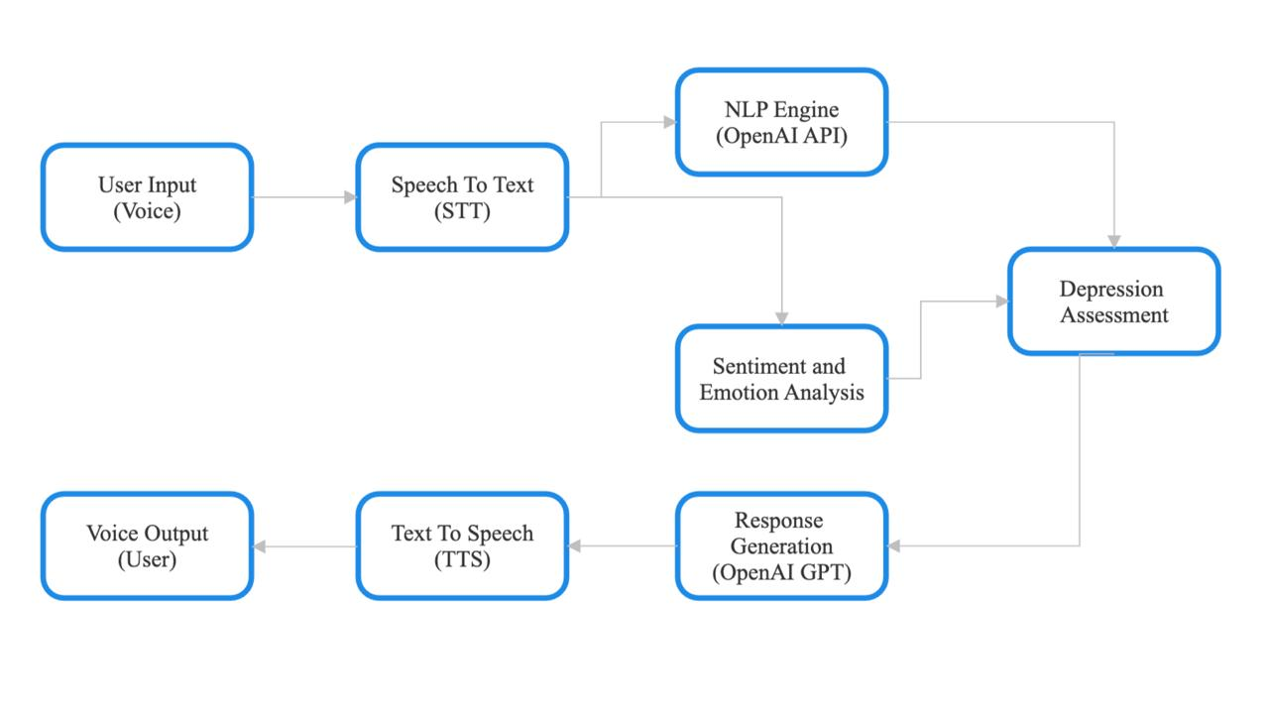
Major Project presentation
Methodology

Slide 7
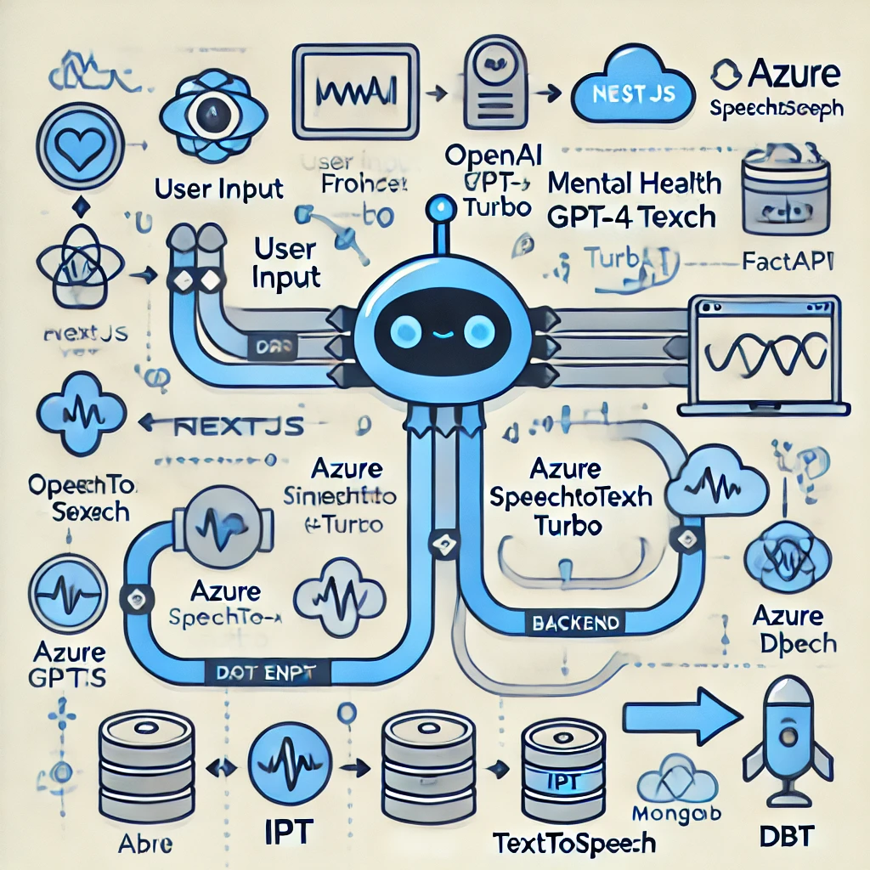
Major Project presentation
Implementation
Backend : FastAPI
Frontend : NextJS
APIs Used : OpenAI gpt-4 turbo, Azure SpeechToText, Azure TextToSpeech
Database : MongoDB
Mental Health specific DataSources : Cognitive Behavioral Therapy (CBT), Interpersonal Psychotherapy (IPT), and Dialectical Behavioral Therapy (DBT) Indexes

Slide 8
Major Project presentation
Result
Increased Access to Mental Health Support: Users will have 24/7 access to a confidential, non-judgmental platform for mental health support, regardless of their location or socioeconomic status.
Improved User Engagement and Well-being: Through personalized, voice-based interactions, users will experience greater comfort in discussing mental health concerns, leading to improved mood, reduced anxiety, and enhanced emotional well-being.
Early Identification of Mental Health Concerns: The chatbot will help users identify early signs of mental health issues by analyzing patterns in their interactions and offering proactive suggestions for seeking professional help when necessary.
Data-Driven Insights for Mental Health Improvement: The system will provide valuable insights based on user interactions, helping users track their mental health over time and offering tailored recommendations for coping strategies and self-care practices.

Slide 9
Major Project presentation
Conclusion
In conclusion, the voice-enabled mental health chatbot project offers a significant step forward in making mental health support more accessible, engaging, and personalized. By leveraging AI and voice interaction, we provide users with a comfortable, non-judgmental platform to discuss their mental health concerns anytime, anywhere. The project not only helps improve emotional well-being but also facilitates early detection of potential mental health issues. With a focus on privacy, user engagement, and continuous support, this solution promises to make a meaningful impact on mental health care, especially for underserved populations.

Slide 10
Major Project presentation
References
https://worlddatabaseofhappiness.eur.nl/studies/holt-et-al-2019-study-us-2017-16679/
https://pubmed.ncbi.nlm.nih.gov/28588005/
https://mental.jmir.org/2018/4/e64/
https://www.greo.ca/Modules/EvidenceCentre/files/Ribeiro%20et%20al%20(2021)_Non-pharmacological%20treatment%20of%20gambling%20disorder_final.pdf
https://psychiatryonline.org/doi/full/10.1176/appi.ajp.2020.20030304

Slide 11
Major Project presentation
Thank You

